Slide 1
Digital Literacy evening 2015
Please complete the quiz on your chair. It is just to help you to think about your child’s use of technology.
We won’t collect them in!

Slide 2
What is Digital Literacy?
Notes:
We let people into our homes everyday via our computers, tablets and phones.

Slide 3
How can You keep them safe?
Keep in touch with what they are doing
Know what games or apps they are using.
Who are their friends online?
Try the game or app yourself.
Be the person they tell.
Notes:
Smartie the penguin.

Slide 4
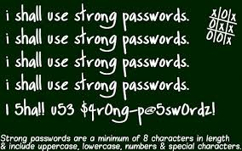
Keeping information Safe
Everything is underpinned by keeping information safe.
Remind your child not to share personal information.
Model good practice. Keep your passwords complex and don’t share them with your child.
If they need to make a password help them to make it with numbers instead of letters e.g. Hotd0g4
Notes:
Use t shirts or hats, shop windows to show what you would share.

Slide 5
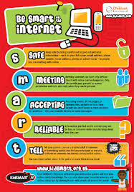
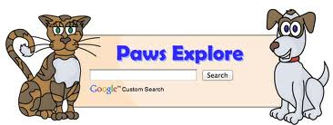
How to be an online parent
Set the ground rules
Use the Smart Rules given by school,
but also adapt them to your household.
Set up Parental controls and Safe Searches.
Make sure you do this on all devices.
Safe search engines are available.
Notes:
New apps for Controlling use

Slide 6
Social Media
This is becoming the biggest problem for parents (and school) to deal with.
Can have them taken down by contacting the social media.
Find out what social media they use. Use it too!
Regularly discuss who are you friends.
Regularly check privacy settings. (They change all the time)
If you can’t get access, then have a relative they trust have access.
Visit http://h2bsafetycentre.com/
Notes:
Kik-no phone numbers
Oovoo-video chat
Burn note like snapchat but self distructs on reading
Vine-short videos to share
Yik Yak-See Yaks anonymously in 5 mile radius
Ask.fm-ask questions
Rooms-chat rooms

Slide 7
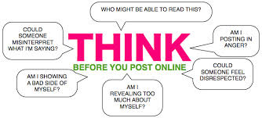
Digital footprint
It is becoming easier and easier to upload things online.
This creates a digital footprint.
Although your child may not yet beusing social media, they need to be aware of creating a digital footprint.
Thinking carefully about what they share online.
Employers and universities are now asking people in interviews to use social media to show why they are suitable for a role.
Notes:
Star wars kid. Drunk monk. What you post is out there

Slide 8
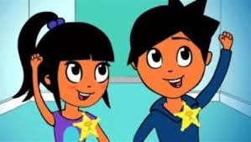
Online Stranger Danger
We teach children not to talk to strangers in the real world.
Now we need to teach them that people aren’t always
what they seem when online.
Are they a real friend or an online friend?
Notes:
Making masks in Early Years, using tv characters in year 1

Slide 9
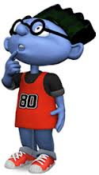
Pop Ups and In app buying
Teach your children to ask if they are going to click something.
Especially younger children just want to make the pop up go away and always sure what they are clicking.
REMIND THEM ABOUT SMART RULES.
Notes:
Hectors world Ooops
Webster on Netsmartz

Slide 10
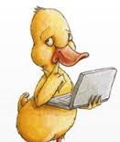
Cyber bullying
When online, we feel anonymous so then we start to think we can say things we would not say in the real world.
We teach children that they are digital citizens and the same rules apply in the digital world that apply in the real world.

Slide 11
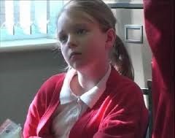
How to deal with Cyber bullying
Save all of the messages. ( Don’t answer back)
Contact school
It is included in our Acceptable use policy, signed by every parent and child.

Slide 12
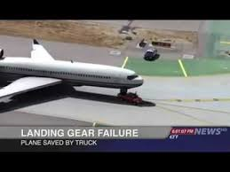
Don’t believe everything!
Children tend to believe it if it written on Google.
Encourage them to ask questions and to check out information from more than one source.
Or simply search to see if it is a hoax.
Notes:
2,798,146 views oin You tube, shared on social media thousands of times. Advert for a Nissan.

Slide 13
The most important thing!
Encourage your child to stop, think and ask questions.
Do I know and trust this person?
Do I trust this website?
Should I click? What will happen?
Should I share or post?
If I’m not sure, TELL AN ADULT.
Notes:
Deal with it in an open and calm way so your child will approach you again.

Slide 14
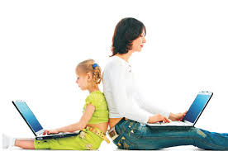
The internet is an exciting place for our children, full of games and answers to their questions.
We must not make them scared of it, but support them to be safe in the digital world, just as we do in the real world.

