Slide 1
The Parents’ and Carers’ Guide to the Internet

Slide 2
What is E-Safety?
E-Safety encompasses the use of Internet technologies and electronic communications such as webcams, digital video equipment, mobile phones and camera phones.
It highlights the need to educate pupils about the benefits, risks and responsibilities of using information technology as well as raising user’s awareness of how to keep themselves safe using electronic technology.
24% of 11 – 16’s who use the internet at home
feel more confident on the internet than in real life
Notes:
2

Slide 3
School Aims
Educate children to be responsible users of ICT
Safe and effective use of ICT at home and at school
Promote the positive uses and benefits of ICT
Raise awareness of the risks

Slide 4
Why are you here today?
Notes:
4

Slide 5
Why are you here today?
48% of children in the UK say there are things on the internet that bother children their own age
24% of 11 – 16’s who use the internet at home
feel more confident on the internet than in real life
48% of parents think their child knows more about the internet then they do
Ofcom 2011
EU Kids Online II
Notes:
5

Slide 7
Benefits of the Internet
Learn through play: educational games and programmes
Research information
Networking: The opportunity to communicate with people from all around the world and to share resources and ideas with people that have the same interests
Shopping around the world without leaving your computer
Multi tasking
Creativity skills

Slide 8
Risks of using the Internet
Privacy
Grooming: Paedophiles use the internet to meet young people
People lying to others online
Bullying using the internet (Cyberbullying)
Seeing inappropriate images and material
Viruses and pop ups
Fraud and Scams

Slide 9
Parents’ and Carers’ Guide
Film

Slide 10
E-Safety @ Archibald
In September all the children from Reception to Year 2 read and discuss Digiducks BIG Decision and watch cartoons from Hector’s World.

Slide 11
E-Safety @ Archibald

Slide 12
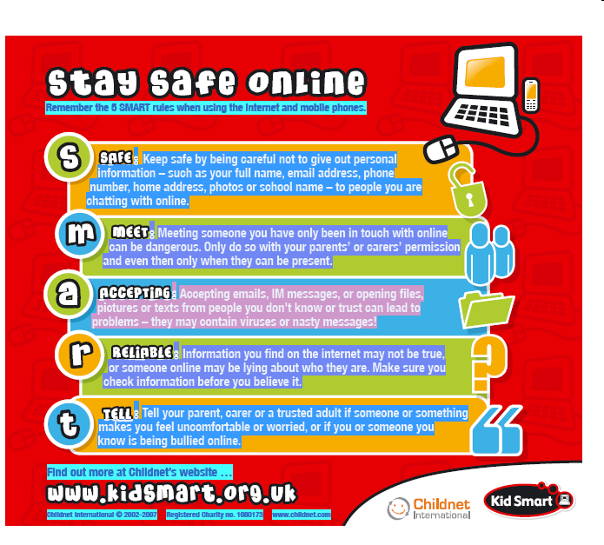
5 Smart Rules

Slide 13
Top Tips Summary
Talk to your child about what they’re up to online.
Watch Thinkuknow films and cartoons with your child.
Keep up-to-date with your child’s development online.
Set boundaries in the online world just as you would in the real world.
Keep all equipment that connects to the internet in a family space.
Use parental controls on devices that link to the internet, such as the TV, laptops, computers, games consoles and mobile phones.

Slide 14
Help your children to understand that they should never give out personal details to online friends
If your child receives spam/junk email and texts, remind them never to believe them, reply to them or use them
It's not a good idea for your child to open files that are from people they don't know
Help your child to understand that some people lie online
Teach young people how to block someone online and report them if they feel uncomfortable

Slide 15
Star Wars Kid
Notes:
The Star Wars Kid
Rated the most watched video in 2006
Sent as an email attachment to millions of people around the world
Become a cult classic
The person in the film is a boy from Quebec who made the video for himself. It was stolen by friends and loaded onto the net, sent to a number of people who then forwarded it on.
He then spent a year a psychiatric care.

Slide 16
E-Safety is not about taking away all of the risks but about minimising these by educating our children.

Slide 17
www.thinkuknow.co.uk/parents

