Slide 1
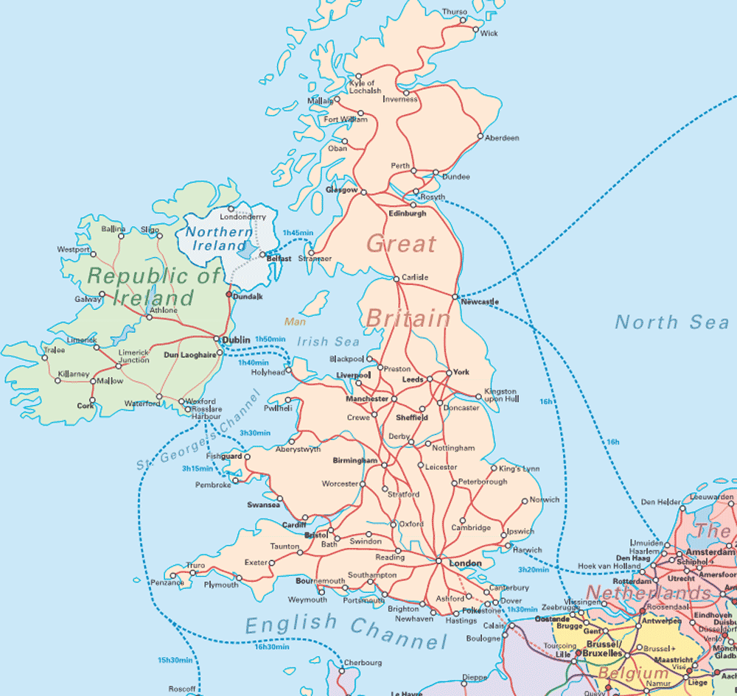
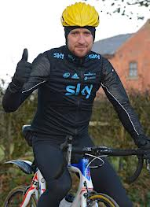
Jessie Ward’s Tour of Britain
Would you like to come on a cycling tour round the British isles ?

Slide 2
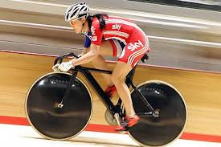
Here I am in Scotland. Scotland. It is in the north. The capital city is Edinburgh. In the highlands there are mountains and lochs.

Slide 3
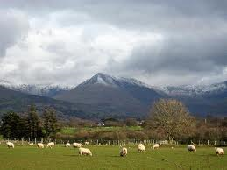
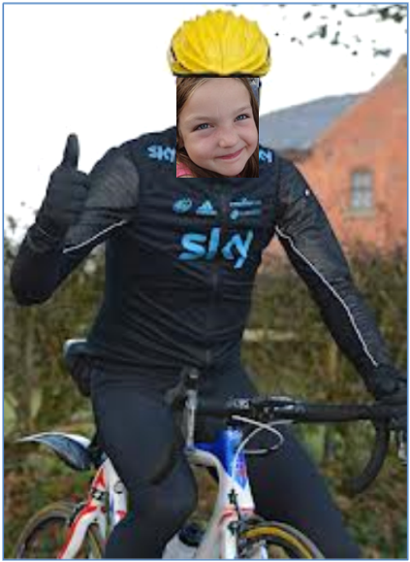
Now I am in Wales. The capital city is Cardiff. I'm tired now because I cycled up mount Snowden. The popular sport is rugby.

Slide 4
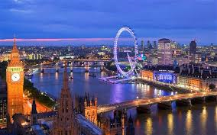
I have arrived in London the capital of England.
It is the biggest city in Britain. I‘m visiting my cousins .

Slide 5
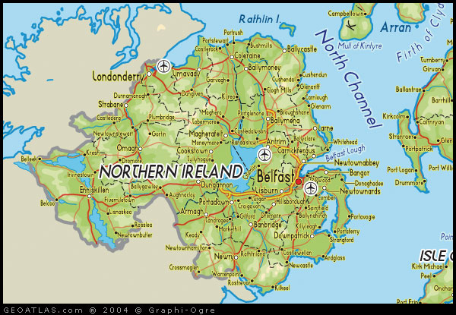
This is northern Ireland . The capital is Belfast.
I might need an umbrella because it rains a lot here.

Slide 6
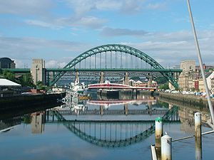
Phew I'm home . I love being back in Newcastle in the North East of England.

